Slide 1
Computer Architecture: Pipelines
Dr. Colin O’Flynn

Slide 2
Lectures
How does a program run on a machine?
How do you compile from high-level code to machine code?
How does the machine run? (Control Flow)
How does the machine store, access, and control data?
How does the machine execute instructions?
How is execution made more efficient?
How do we measure execution?

Slide 3

Pipeline Context

Slide 4
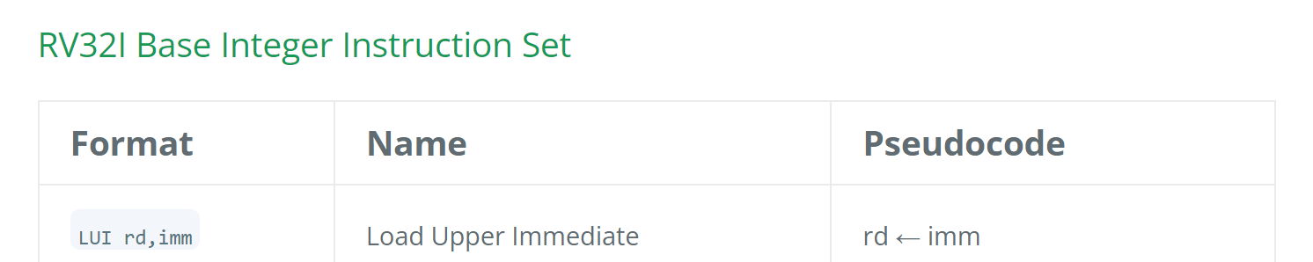
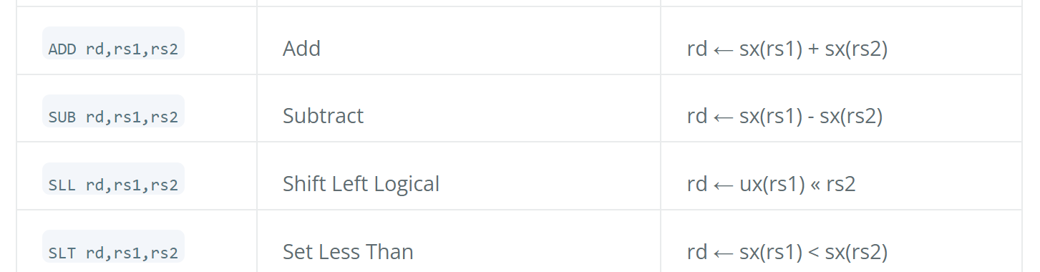
RISC-V Instruction Set

Slide 5
A Simple RISC-V Program
C (High Level)
ASM (Lower Level)
Binary / Machine
int AddAndMul(int a, int b){
int c;
c = a + b;
c = c * a;
c = c * b;
return c;
}
AddAndMul(int, int):
add a5,a0,a1
mul a0,a5,a0
mul a0,a1,a0
ret
Compiler
Assembler
0x00b507b3
0x2a78533
0x2a58533
0x8082
NOTE: in RISC-V a0/a1/etc are general-purpose registers.

Slide 6
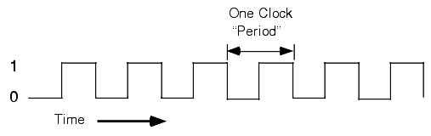
Executing a Simple Program (Naïve)
a5 = a0 + a1
Decode Logic
add a5,a0,a1
ALU
0x00b507b3
0x2a78533
0x2a58533
0x8082
0x00b507b3
PC
a0
a
+
c
a5
a1
b
Storage Media

Slide 7
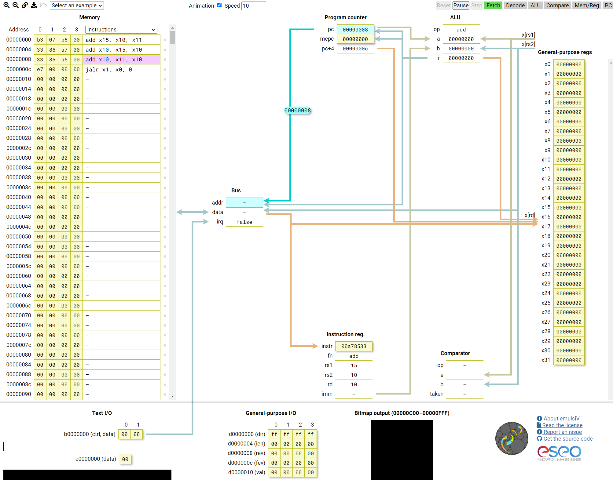
e.g., interactive simulation
add x15, x10, x11
add x10, x15, x10
add x10, x11, x10
jalr x1, x0, 0
https://eseo-tech.github.io/emulsiV/

Slide 8
About Logic Propagation Time

Slide 9
Simple Pipeline Example
Clock Cycle: 1 2 3 4
Fetch
0x00b507b3
0x2a78533
0x2a58533
0x8082
0x00b507b3
0x2a78533
0x2a58533
0x8082
Decode
add a5,a0,a1
mul a0,a5,a0
mul a0,a1,a0
Execute
a5 = a0 + a1
a0 = a5 × a0
Time
Storage Media
NOTE: in RISC-V a0/a1/etc are general-purpose registers.

Slide 10





Human Pipelining Examples
You probably already “pipeline” lots of tasks, e.g.:
Doing laundry
Cooking / Baking
Making instant noodles
Open Ramen & Packets / Grab Utensils
Pour Water
Wait
Eat
Fill and Turn On Kettle

Slide 11
2 vs 3 vs 5 vs … stage pipeline
Frontend
Backend
Plans the code the backend will execute. Goal is to keep the backend busy as much as possible.
Actually executes the instructions, including writing anything to memory or registers.
(1) Instruction Fetch & Decode
(2) Execute & Writeback
(1) Instruction Fetch (2) Decode
(3) Execute & Writeback
(1) Instruction Fetch (2) Decode
(3) Execute (4) Writeback
(1) Instruction Fetch (2) Decode
(3) Execute (4) Memory (5) Register Writeback

Slide 12
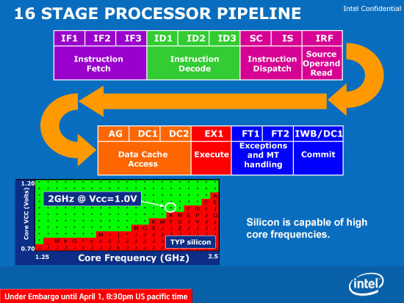
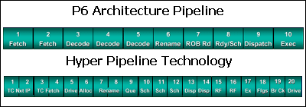
Substages within Stages
Intel Atom (2008)
Pentium 4 had 20 stage pipeline(2000). A later version (P4E, 2004) went up to 31. Things have calmed down since then.

Slide 13
Pipeline Hazards
Control hazard
Need result of a conditional (branch?) before conditional result is ready
Structural hazard
Need the same resource (e.g., multiplier hardware)
Data hazard
Instruction to execute needs result of not-finished instruction

Slide 14
What Hazards are Here?
Clock Cycle: 1 2 3 4
Fetch
0x00b507b3
0x2a78533
0x2a58533
0x8082
Decode
add a5,a0,a1
mul a0,a5,a0
mul a0,a1,a0
Execute
a5 = a0 + a1
a0 = a5 × a0
Time

Slide 15
Remember – Logic can be SLOW

Slide 16
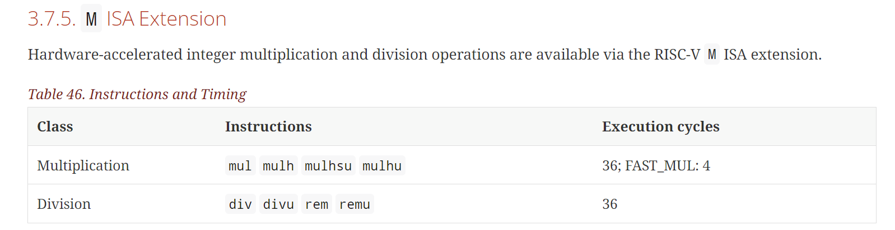
Example – NEORV32 Multiply Timing
https://stnolting.github.io/neorv32/

Slide 17
Example: 2-Cycle Multiply
Clock Cycle: 1 2 3 4 5
Fetch
0x00b507b3
0x2a78533
0x2a58533
0x8082
Decode
add a5,a0,a1
mul a0,a5,a0
mul a0,a1,a0
ret
Execute
a5 = a0 + a1
a0 = a5 × a0
a0 = a5 × a0
Time
Here is BOTH a structural hazard & a data hazard (if we had another multiplier)

Slide 18
Example: 2-Cycle Multiply
Clock Cycle: 4 5 6 7 8
Fetch
0x8082
0x8082
…
…
Decode
mul a0,a1,a0
mul a0,a1,a0
ret
ret
…
Execute
a0 = a5 × a0
a0 = a1 × a0
PC = ra
Time
NOTE: in RISC-V a0/a1/etc are general-purpose registers. ra is “Return Address” register (typically ‘Link Register’ in Arm).

Slide 19
Pipeline Stalls
Stall:
Pause the pipeline while waiting for availability of resource (e.g., the slow multiply).

Slide 20
Example: Branch Instruction
C (High Level)
ASM (Lower Level)
Binary / Machine
int comp(int a, int b){
if (a > b){
return a+b;
} else {
return a-b;
}
}
comp(int, int):
bge a1,a0,16 <.L3>
add a0,a0,a1
ret
.L3:
sub a0,a0,a1
ret
Assembler
0x00a5d463
0x952e
0x8082
0x8d0d
0x8082
Compiler

Slide 21
Pipeline with Branch
Clock Cycle: 1 2 3 4
Fetch
0x00a5d463
0x952e
0x8082
0x8d0d
0x00a5d463
0x952e
0x8082
0x8d0d
0x8082
Decode
bge a1,a0,16 <.L3>
add a0,a0,a1
ret
Execute
PC =.L3 if a1 ≥ a0
a0 = a0 + a1
Time
Storage Media
NOTE: in RISC-V a0/a1/etc are general-purpose registers.

Slide 22
Pipeline with Branch
Clock Cycle: 1 2 3 4 5
Fetch
0x00a5d463
0x952e
0x8082
0x8d0d
0x8082
0x00a5d463
0x952e
0x8082
0x8d0d
0x8082
Decode
bge a1,a0,16 <.L3>
add a0,a0,a1
💀
sub a0,a0,a1
Execute
PC =.L3 if a1 ≥ a0
💀
Time
Storage Media
NOTE: in RISC-V a0/a1/etc are general-purpose registers.

Slide 23
Pipeline Flush
Flush:
Control flow change means pipeline had the wrong instructions – need to throw away the current contents.

Slide 24
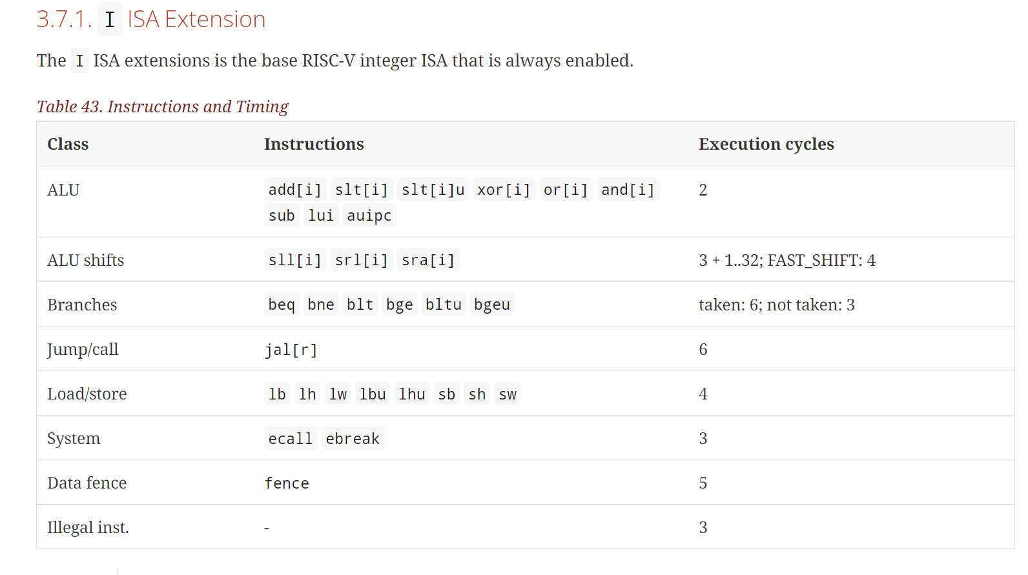
e.g. Typical Specifications – Instruction Latency
https://stnolting.github.io/neorv32/

Slide 25
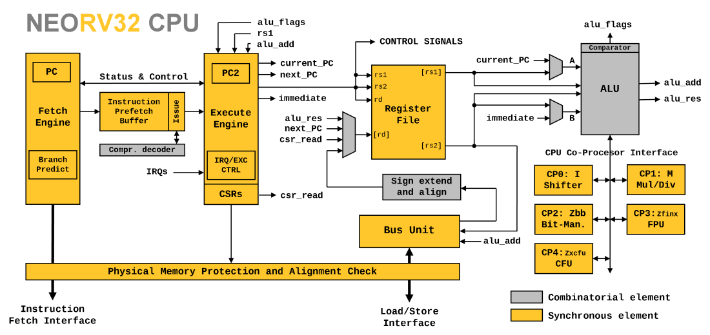
Example: A Simple CPU Architecture

Slide 26
Branch / Pipeline Stall
Q: In previous example – why not just stall pipeline until result is known?
A: Don’t know about the branch until “later” in pipeline.
A: It’s more efficient to just assume branch isn’t taken & keep pipeline up. If branch is random you are right 50% of the time, rather than stalling 100% of the time.

Slide 27

Branch Prediction
What if we could predict which branches that will be taken? Could get better than 50%! Don’t need time travel even…

Slide 28
Motivation for Branch Prediction
loop(char*, int):
addi sp,sp,-16
sw s0,8(sp)
sw s1,4(sp)
sw s2,0(sp)
sw ra,12(sp)
mv s2,a0
mv s1,a1
li s0,0
.L6:
blt s0,s1,.L7
lw ra,12(sp)
lw s0,8(sp)
lw s1,4(sp)
lw s2,0(sp)
addi sp,sp,16
jr ra
.L7:
add a5,s2,s0
lbu a0,0(a5)
addi s0,s0,1
call process_byte(char)
j .L6
for(int i = 0; i < datalen; i++){
process_byte(data[i]);
}

Slide 29
Motivation for Branch Prediction
In this loop example → branch will be taken continuously until only the final iteration. Imagine if datalen = 512, branch not taken 0.195% of time!
The default pipeline behaviour of “assume branch not taken” will have a large (negative) impact on this code-path!
e.g., for NEORV32, adds +3 additional cycles to the loop iteration each time it’s wrong.

Slide 30
Branch Prediction Example: Pentium
Branch prediction logic: holds some statement information about latest N seen branch instructions. This state indicates the likely output of the branch:
History Bits | Resulting Description | Prediction made | If branch taken | If branch not taken
11 | Strongly Taken | Branch Taken | Remains in same state | Downgraded to weakly taken
10 | Weakly Taken | Branch Taken | Upgraded to strongly taken | Downgraded to weakly not taken
01 | Weakly Not Taken | Branch Not Taken | Upgraded to weakly taken | Downgraded to strongly not taken
00 | Strongly Not Taken | Branch Not Taken | Upgraded to weakly not taken | Remains in same state
https://www.geeksforgeeks.org/branch-prediction-in-pentium/

Slide 31
Branch Prediction to Speculative Execution
Systems may speculatively execute instructions once we have branch prediction.
Based on predicted branch, load new data into pipeline, and start executing it if something is slow (e.g., waiting on memory).
Need to “unwind” any executed instructions if branch wasn’t taken.
e.g., can’t start writing to registers yet!

Slide 32
Out of Order Execution
ooo(int, int, int):
mul a5,a0,a1
addi a5,a5,14
add a0,a0,a1
add a0,a0,a2
mul a0,a5,a0
ret
int ooo(int a, int b, int c){
int e = a * b + 14;
int f = a + b + c;
return e * f;
}

Slide 33
Out of Order Execution
ooo(int, int, int):
mul a5,a0,a1
addi a5,a5,14
add a0,a0,a1
add a0,a0,a2
mul a0,a5,a0
ret
int ooo(int a, int b, int c){
int e = a * b + 14;
int f = a + b + c;
return e * f;
}

Slide 34
Out of Order Execution
Clock Cycle: 1 2 3 4 5
Execute
a5 = a0 * a1
a5 = a5 + 14
a0 = a0 + a1
a0 = a0 + a2
Time
ooo(int, int, int):
mul a5,a0,a1
addi a5,a5,14
add a0,a0,a1
add a0,a0,a2
mul a0,a5,a0
ret

Slide 35
Out of Order Execution
Clock Cycle: 1 2 3 4 5
Execute
a5 = a0 * a1
a5 = a5 + 14
a0 = a0 + a1
a0 = a0 + a2
Time
ooo(int, int, int):
mul a5,a0,a1
addi a5,a5,14
add a0,a0,a1
add a0,a0,a2
mul a0,a5,a0
ret

Slide 36
Interrupts
Fetch
0x00b507b3
0x2a78533
0x2a58533
0x8082
Decode
add a5,a0,a1
mul a0,a5,a0
mul a0,a1,a0
Execute
a5 = a0 + a1
a0 = a5 × a0
Time

Slide 37
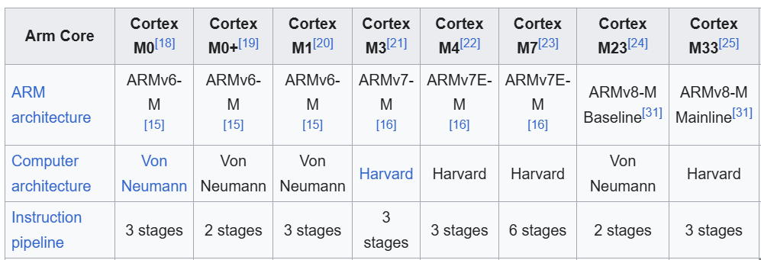
Cortex-M Pipeline Comparisons
https://en.wikipedia.org/wiki/ARM_Cortex-M

Slide 38
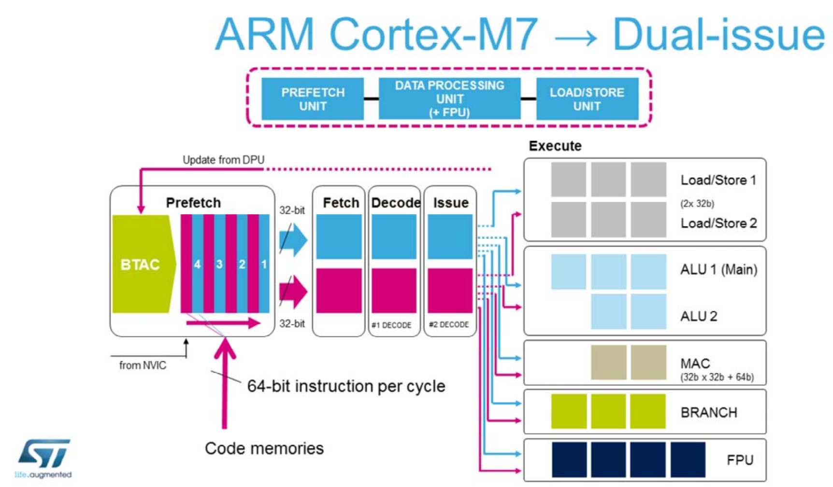
6-Stage Pipeline?

Slide 39
Pipeline Summary
Pipelining is a natural way to improve throughput.
Pipelines are typically 2~5 stages in most microcontrollers you’ll use.
Stages split between Frontend & Backend
Frontend: Fetch, Decode
Backend: Execute, Memory Access, Writeback (Commit)
Pipeline hazards cause a pipeline to stall or require a flush.
Pipelines may feature branch prediction, out of order execution, and speculative execution features to improve throughput.

